Slide 1
React: 从入门到入土

Slide 2
Learning Path
Learn the basics
HTML
CSS
JavaScript
Modified from: https://github.com/kamranahmedse/developer-roadmap

Slide 3
Basics
HTML
CSS
JavaScript
Structure
Layout
Design
Behavior

Slide 4
Basics
HTML
CSS
JavaScript
Structure
Layout
Design
Behavior

Slide 5
Learning Path
Learn the basics
HTML
CSS
JavaScript
React
Choose a framework
Angular
Vue
…
Modified from: https://github.com/kamranahmedse/developer-roadmap

Slide 6
React framework
A JavaScript library for building interactive user interfaces

Slide 7
React framework
A JavaScript library for building interactive user interfaces

Slide 8
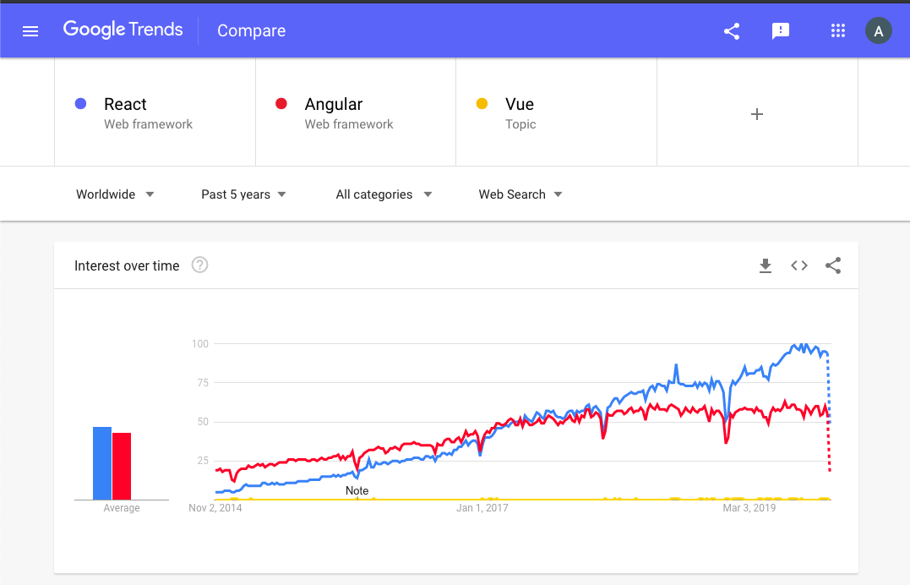
React framework

Slide 9
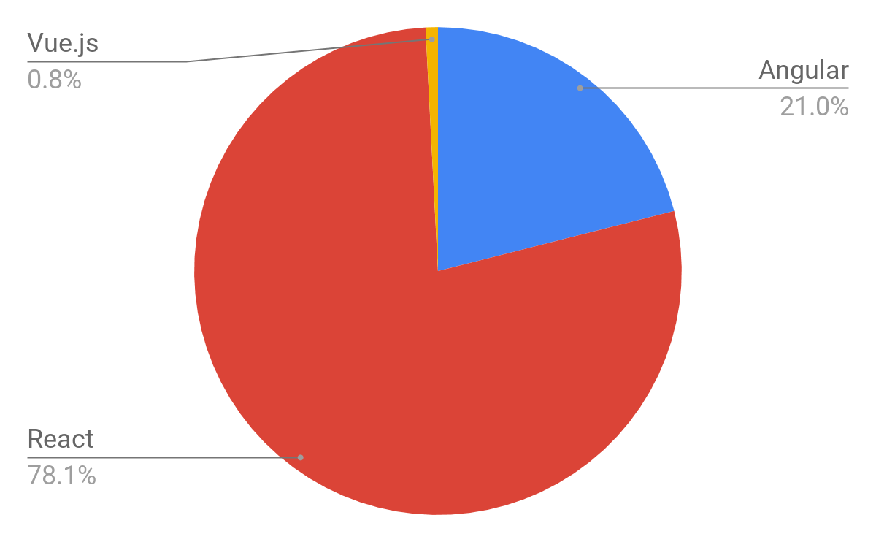
React framework
Open Job Positions

Slide 10
Learning Path
Learn the basics
HTML
CSS
JavaScript
React
Choose a framework
Angular
Vue
…
Going deeper
Pre-processors
ES6+
CSS
Frameworks
Calling APIs
JavaScript
Redux
Type Checkers
React
Hooks
HOCs
Modified from: https://github.com/kamranahmedse/developer-roadmap

Slide 11
Basics of React

Slide 12
Basics of React
Components
Props
State
JSX

Slide 13
Components
Building blocks
Reusable

Slide 14
Components

Slide 15
Components
Props
State
External inputs
“Messages”
Internal information store
“Memory”

Slide 16
Components
Props
Component
UI
State

Slide 17
Components: Lifecycle
Props
Component
UI
State

Slide 18
Components: Lifecycle
Props
Component
UI
State

Slide 19
Components: Lifecycle
Props
Component
UI
State

Slide 20
Components: Lifecycle
Props
Component
UI
State

Slide 21
Components: Lifecycle
Props
Component
UI
State

Slide 22
Components: Lifecycle
Props
Component
UI
State

Slide 23
Components: Lifecycle
Props
Component
UI
State

Slide 24
Components: Lifecycle
Props
Component
UI
State

Slide 25
Components: Lifecycle
Props
Component
UI
State

Slide 26
JSX
HTML + JavaScript
Structure + Behavior
Write and add HTML easily in React
Just one file for HTML + JavaScript!

Slide 27
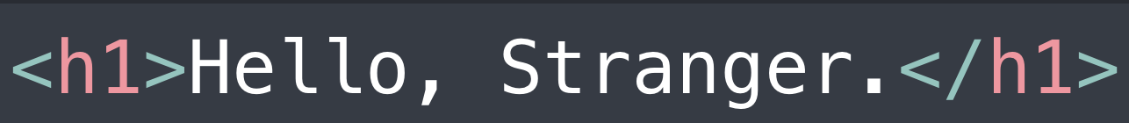
HTML
HTML - Hypertext Markup Language

Slide 28
HTML
HTML - Hypertext Markup Language
Structure content using tags
Opening Tag
Closing Tag

Slide 29
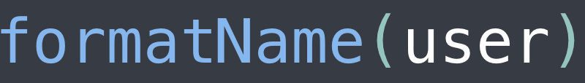
JavaScript
JavaScript – Programming language

Slide 30

JSX
HTML + JavaScript

Slide 31
JSX
HTML + JavaScript
JavaScript is placed in curly braces

Slide 32
That’s all you need to know to start building!

Slide 33
Let’s get started!

Slide 34
Setting up your environment
Download
Visual Studio Code
Node v13.0.1 (https://nodejs.org)
Install

Slide 35
Setting up your environment 2
Open
(mac) Terminal
(win) Power Shell
Change directory
cd Desktop
Create a skeleton project
npm create-next-app PROJECTNAME
cd PROJECTNAME

Slide 36
Setting up your environment 3
Open VS Code
code .
Run project
npm (run) start

